Slide 1
Lab 10 Help Session Part 1
Getting Started
The Arena
Bullet Proofing

Slide 2
What are we building?
RPG – Role Playing Game
Test Driver will use the program
No Main

Slide 3
What files do we have?
Let’s Download
You will have your own copy of the test driver
All your code goes into Student Code File

Slide 4
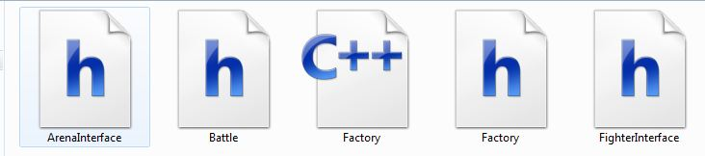
Files

Slide 5
What is an Interface?
Keeps Method calls uniform

Slide 6
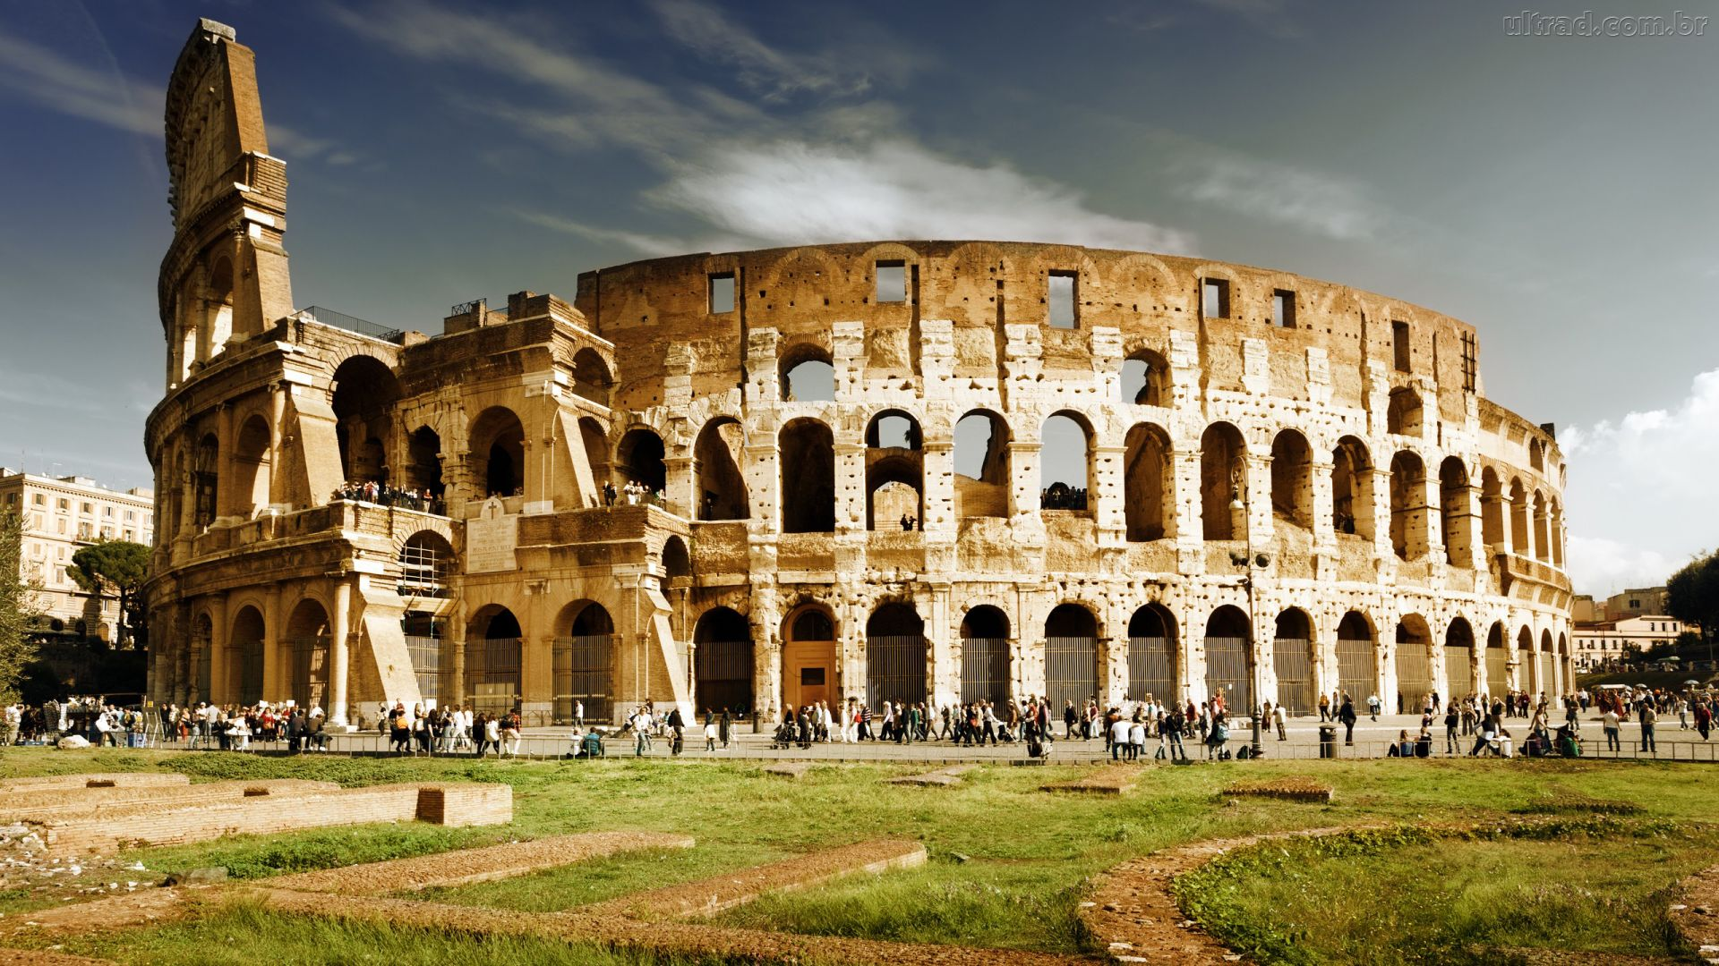
Arena: Conceptually

Slide 7
Arena: Code Conceptually
ArenaInterface.h
Arena Class

Slide 8
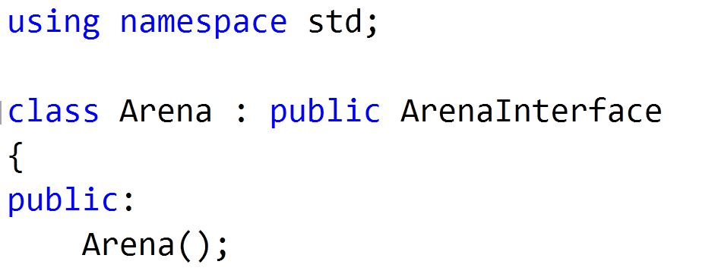
Make Arena Class Inherit

Slide 9
What does ArenaInterface.h tell us?
We need to add our Own Arena Class
In Our Arena Class:
What methods do we need to have?
What variables do we need to have in out Arena?

Slide 10
Example RemoveFighter

Slide 11
Bullet Proofing – addFighter
Need right amount of info
Duplicate
Not Archer Cleric or Robot
Stats > 0

Slide 12
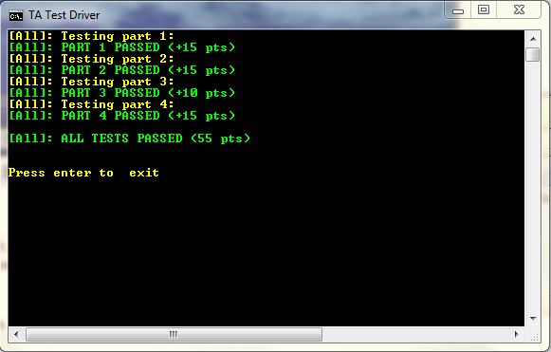
Pass Off Result

